Slide 1






BUTCHERY MANAGEMENT
KEY TOPICS
Appex Butchery Management System
POS Operations
Weight-based sales
Meat Processing
Batch management
Inventory Control
Staff Training Guide
Freshness tracking
Reports & Analytics
Yield analysis
Complete Guide to POS, Processing & Inventory Operations

Slide 2








Introduction - Key Features
Section 1
Specialized Solution: Point-of-sale and inventory management designed specifically for butcheries, meat processing plants, and meat retail operations
Meat Processing
Weight-Based Pricing
Freshness Tracking
Cutting management
Accurate kg pricing
Expiry monitoring
Batch tracking
Scale integration
Temperature alerts
Processing efficiency
Cut-specific pricing
Quality control
Batch & Lot Tracking
Quality Control
Customer Loyalty
Complete traceability
Inspection records
Points & rewards
Source tracking
Quality monitoring
Customer programs
Processing history
Compliance tracking
Bulk pricing

Slide 3





Getting Started - Login Process
Section 2.1
Login Steps
Security
1
Open Browser
5
Two-Factor Authentication
Navigate to appex.co.zw/login
Enter code sent to your phone (if enabled)
2
Enter Username
First-Time Login
Your registered email address
You'll be prompted to change your temporary password
3
Enter Password
Password Security
Your secure password
Use strong, unique passwords for your account protection
Click Login
Need Help?
4
Contact your administrator if you have login issues
Press the "Login" button

Slide 4

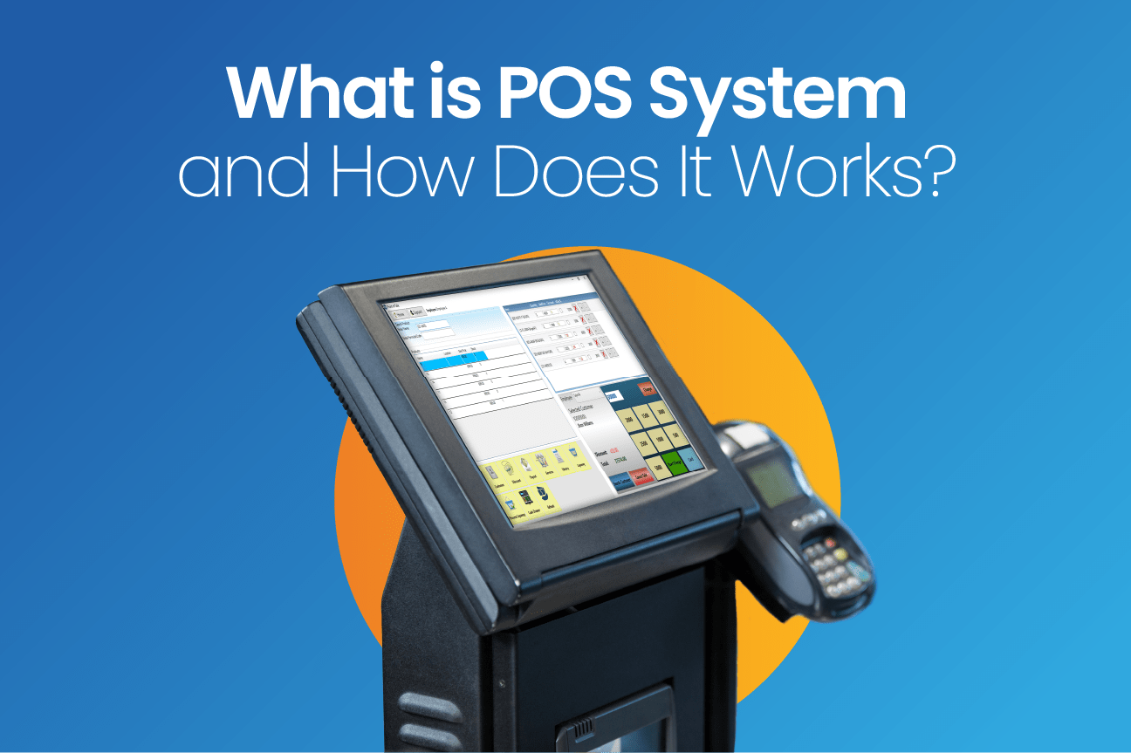












First-Time Setup
Section 2.2
Setup Wizard
1
Business Information
Butchery Name
Type
Address
Phone
Logo
2
Currency Settings
USD / ZWL
|
Dual Pricing
3
Butchery Settings
Processing Options
Waste %
Freshness Tracking
Temperature Monitor
4
User Accounts
Create Staff
|
Assign Roles
|
Set Permissions
5
Complete Setup
Setup Wizard: Guides you through initial configuration
Review All Settings
→
Go to Dashboard

Slide 5













Dashboard Overview - Layout
Section 3.1
Top Navigation Bar
Main Dashboard Sections
Business Name/Logo
Top Left
Quick Stats
Performance Charts
Today's sales, transactions, Meat processed
Sales trends, Top products. Efficiency
Search Bar
Center - Products, Customers, Transactions
Notifications Bell
Top Right - Low stock, expiring alerts
Quick Actions
Recent Activity
New Sale. Process Meat. Check Stock
Sales. Processing. Inventory updates
User Profile
Account settings, Logout
Alerts & Notifications
Currency Toggle
Switch USD/ZWL display
Low stock alerts · Expiring products · Temperature alerts · Quality control reminders
Branch Selector
Multiple locations

Slide 6











Dashboard Overview - Quick Stats & Performance
Section 3.1 & 3.2
Quick Stats
Performance Charts
Today's Sales
Transactions
Sales Trend
Top-Selling Products
$12,450
48
Daily / Weekly / Monthly
Best performers
Processing Efficiency
Waste Tracking
Meat Processed
Low Stock
Output vs Input
Loss percentage
156 kg
5 Items
Real-time Insights: Monitor butchery performance at a glance with comprehensive analytics
Expiring Products
Active Customers
8 Items
234

Slide 7















Dashboard Overview - Actions & Activity
Section 3.3 - 3.5
Quick Actions
Alerts & Notifications
Low Stock Alerts
New Sale
Process Meat
Receive Stock
Items below reorder point
Expiring Products
Products near sell-by date
Check Stock
Create PO
Temperature Alerts
Recent Activity
Sensor deviation warnings
Quality Control Reminders
Recent Sales
Scheduled checks due
Latest transactions
Processing Activities
Proactive Monitoring: Stay ahead of issues with real-time alerts and notifications
Recent batch operations
Inventory Adjustments
Stock updates & changes
Customer Additions
New customer registrations

Slide 8





Sales & POS Operations - Accessing & Interface
Section 4.1 & 4.2
POS Interface Layout
Access POS
Left Panel
Center Panel
Right Panel
Product Selection
Shopping Cart
Customer & Payment
1
Click "Sales"
Category Tabs
Cart Items
Customer Section
In left sidebar menu
Beef • Pork • Chicken
Product list
Search or add new
Product Grid
Quantities
Loyalty Points
2
Select "New Sale"
Quick selection buttons
kg or pieces
Points balance display
Or use quick action button
Search Bar
Price per kg/unit
Payment Methods
Find specific products
Unit pricing
Cash • EcoCash • Card
Quick Access: Click the "New Sale" button on dashboard
Barcode Scanner
Subtotal & Total
Payment Processing
Camera scanning option
Cart totals
Complete transaction

Slide 9







Processing a Sale - Steps 1-3
Section 4.3
1
Select Products
Visual Process
Click on product category
Click on product name
Categories
Product Grid
Beef • Pork • Chicken
Quick selection
Enter quantity (kg or pieces)
Click "Add to Cart"
Search Bar
Scanner
OR Use Barcode Scanner
Find products fast
Scan barcode
Weight-based pricing ensures accurate charges for meat products
2
Apply Weight
For variable weight items
Weight popup appears
Enter weight in kilograms
Price auto-calculates
Click "Add" button
3
Apply Discounts
Click "Add Discount"
Enter discount % or fixed amount
Select discount reason
Click "Apply"
Optional step

Slide 10















Processing a Sale - Steps 4-6
Section 4.3 Continued
4
Identify Customer
Payment Methods
Search Customer
Add New
Cash
EcoCash
By name or phone
Create new customer
OneMoney
ZimSwitch
Loyalty points auto-apply
Bank Transfer
5
Process Payment
Select payment method
Enter amount tendered
Quick Tips
System calculates change
Receipt sent automatically to customer if email/phone provided
Click "Complete Sale"
Loyalty points earned on each purchase
Multiple payment methods can be combined
6
Receipt Options
Print
WhatsApp
Email
SMS
View

Slide 11









Special Butchery POS Features
Section 4.4
Key Benefits
Weight Scale Integration
Cut-Specific Pricing
Precision Pricing
Accurate weight-based charges
Connect via Bluetooth/USB
Different prices per cut
Weight auto-populates
Same animal pricing
Complete Tracking
Every product monitored
Accurate pricing
Tracks available cuts
Flexible Sales
Retail & wholesale options
Butchery-Specific
By-Product Sales
Bulk Sales
Features designed specifically for meat processing and retail operations, ensuring accuracy and efficiency.
Bones, fat, offal
Contractor special pricing
Sold as separate products
Credit account integration
Inventory tracking
Volume discounts

Slide 12









Managing Returns
Section 4.5
5
Enter Reason
6
Refund Method
1
Navigate to Sales History
Click Sales → Sales History in sidebar
Select from dropdown or type custom reason
Cash • EcoCash • Store Credit
7
Process Return
8
Complete
2
Find Transaction
Search by receipt number or customer name
Click "Process Return"
Inventory auto-updated
Important Notes
3
Select Return
Returns must match original transaction
Click "Process Return" button
Partial returns allowed
Quality check required for perishables
4
Select Items
Check boxes next to items being returned

Slide 13














Meat Processing Management
Section 5.1
Accessing
Input Section
Output Section
Click "Processing" in sidebar
Source Product
Output Products
Select "New Processing Batch"
Select whole cuts or carcass
Add processed cuts
Input Weight
Expected Output
Processing screen opens with all necessary fields
Enter weight in kg
Based on yield %
Batch Number
Actual Output
Auto-generated or manual
Enter actual weight produced
Processing Flow
Processing Date
Operator
Waste
INPUT
Whole cuts / carcass
Auto-calculated
PROCESSING
Cutting & preparation
OUTPUT
Processed cuts + waste

Slide 14










Creating a Processing Batch - Steps 1-3
Section 5.3
1
Select Source Product
2
Enter Input Details
3
Add Output Products
Choose from Inventory
Input Weight
Click "Add Output Product"
Click "Select Source Product"
200 kg
T-Bone Steak
Whole Beef Carcass
Available: 150 kg
Expected
Actual
15 kg
14.5 kg
Batch Number
Pork Side
Available: 80 kg
Waste: 0.5 kg
Auto-Generate
Custom Entry
Chicken Whole
Available: 200 kg
Repeat for all cuts
Select Operator
System shows available quantity for each product in inventory
Choose staff member

Slide 15













Creating a Processing Batch - Steps 4-6
Section 5.3 Continued
4
Review Calculations
6
Complete Processing
Total Input
Total Output
Waste
Waste %
Click "Save Processing Batch"
200 kg
150 kg
50 kg
25%
Save your batch to proceed
Compare to Expected Yield
System Updates Inventory:
Reduces source product quantity
5
Quality Control
Adds output products to inventory
Quality Check Results
Records waste
Temperature Readings
All changes automatically tracked in system
Add Notes
Passed
Failed

Slide 16








Processing Reports
Section 5.4
Access Processing History
Yield Analysis Reports
Navigate to Processing
Input Metrics
Output Metrics
Select "Processing History"
Total Weight Processed
1,250 kg
Total Output
938 kg
Batches Completed
48
Yield Rate
75%
Avg Batch Size
26 kg
Waste Recorded
312 kg
View All Processing Batches
Date
Operator
Product
Processing Efficiency Over Time
Daily
Weekly
Monthly
Export Data
Excel
PDF
Mon
Tue
Wed
Thu
Fri
Sat
Sun

Slide 17







Introduction - Key Features
Section 1
Specialized POS & Inventory Management
Designed specifically for butcheries, meat processing plants, and meat retail operations
Meat Processing
Weight-Based Pricing
Freshness Tracking
Cutting management & batch tracking
Accurate kg/unit pricing system
Expiry monitoring & alerts
Quality Control
Batch & Lot Tracking
Customer Loyalty
Monitoring & compliance checks
Complete traceability system
Points & rewards programs
All-in-one solution for modern butchery operations management

